Slide 1

Chapter 3:
Pattern Discovery in Data Mining
Notes:
‹#›

Slide 2
Mining Sequential Patterns
Objective
Introduction to sequential pattern mining and its applications
Algorithms for mining sequential patterns, such as GSP (Generalized Sequential Pattern) algorithm
Challenges and considerations in sequential pattern mining
‹#›

Slide 3
Mining Sequential Patterns
Sequential Patterns
Introduction to Sequential Patterns:
Sequential patterns refer to patterns that capture the temporal order of events or items in a sequence.
They represent frequent subsequences or episodes in sequential data.
‹#›

Slide 4
Mining Sequential Patterns
Sequential Patterns
Importance of Sequential Patterns:
Sequential patterns provide insights into temporal dependencies and patterns of events.
They are valuable in various domains such as customer behavior analysis, web log analysis, and process mining.
‹#›

Slide 5
Mining Sequential Patterns
Sequential Pattern Mining
What is Sequential Pattern Mining?
Sequential pattern mining aims to discover frequent sequences or episodes in sequential data.
It involves identifying patterns that occur frequently and maintain the temporal order of events.
‹#›

Slide 6
Mining Sequential Patterns
Sequential Pattern Mining
Applications of Sequential Pattern Mining:
Market Basket Analysis:
  Identifying frequently occurring sequences of items in customer transactions.
  Discovering purchase patterns and associations between items.
Web Log Analysis:
  Analyzing website clickstreams to understand user navigation patterns.
  Identifying frequently visited sequences of webpages.
Process Mining:
  Analyzing event logs to uncover process flows and dependencies.
  Discovering frequent execution sequences in business processes
‹#›

Slide 7
Mining Sequential Patterns
GSP: Apriori-based Sequential Pattern Mining
Introduction to GSP Algorithm:
GSP (Generalized Sequential Pattern) is an apriori-based algorithm for mining sequential patterns.
It extends the Apriori algorithm to handle sequential data.
‹#›

Slide 8
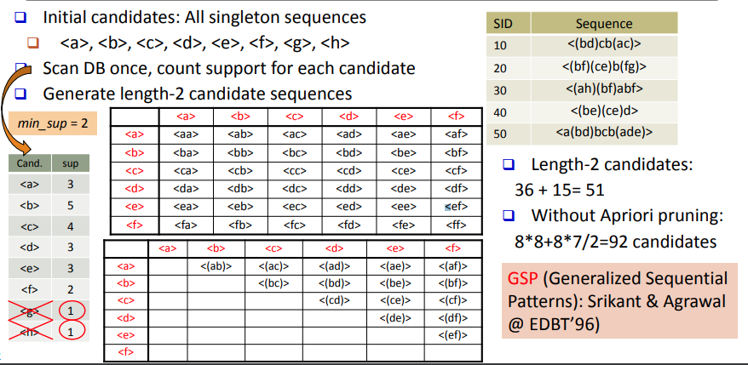
Mining Sequential Patterns
GSP: Apriori-based Sequential Pattern Mining
‹#›

Slide 9
Mining Sequential Patterns
GSP: Apriori-based Sequential Pattern Mining
Steps of GSP Algorithm:
Candidate Generation:
  Generate candidate sequences by combining frequent (k-1)-length sequences.
Support Counting:
  Scan the database to count the support of each candidate sequence.
  Support is the number of occurrences of a sequence in the dataset.
‹#›

Slide 10
Mining Sequential Patterns
GSP: Apriori-based Sequential Pattern Mining
Steps of GSP Algorithm:
Pruning:
  Remove infrequent sequences based on the minimum support threshold.
Iteration:
  Repeat the candidate generation, support counting, and pruning steps until no more frequent sequences can be discovered.
‹#›

Slide 11
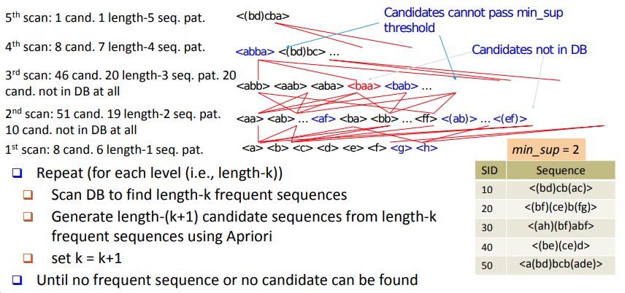
Mining Sequential Patterns
GSP: Apriori-based Sequential Pattern Mining
‹#›

Slide 12
Mining Sequential Patterns
Example: Mining Sequential Patterns with GSP
Consider a retail scenario with a dataset of customer transactions, where each transaction represents the sequence of items purchased.
Using GSP algorithm, we can discover sequential patterns such as:
{A, B, C}: A common sequence where items A, B, and C are frequently purchased together in that order.
{D, E}: A frequent subsequence where items D and E occur consecutively.
These sequential patterns provide insights into customer purchasing behavior and help optimize product placement or recommend related items
‹#›

Slide 13
Mining Sequential Patterns
Advantages of GSP Algorithm
Apriori-based Approach:
The GSP algorithm builds on the well-known Apriori principle for efficient pattern mining.
It leverages the candidate generation and pruning steps to effectively identify frequent sequential patterns.
‹#›

Slide 14
Mining Sequential Patterns
Advantages of GSP Algorithm
Flexible Minimum Support Threshold:
GSP allows users to define a minimum support threshold to control the minimum occurrence frequency of discovered sequential patterns.
Adjusting the threshold helps focus on more significant patterns or explore more detailed patterns.
‹#›

Slide 15
Mining Sequential Patterns
Limitations and Considerations
Computational Complexity:
Sequential pattern mining can be computationally intensive, especially for large datasets.
Optimization techniques, such as indexing and pruning strategies, are often employed to handle scalability.
‹#›

Slide 16
Mining Sequential Patterns
Limitations and Considerations
Parameter Tuning:
Choosing an appropriate minimum support threshold impacts the number and significance of discovered sequential patterns.
Finding the right balance between inclusiveness and specificity requires experimentation and domain knowledge.
‹#›

Slide 17
Summary
Sequential Pattern Mining
Discover temporal patterns in data.
GSP algorithm for efficient discovery.
Challenges include scale and complexity.
‹#›

